Slide 1



Soundec 深圳市九音科技
SNC8600 Audio DSP SoC V1.7_en
32 bit processor/ HiFi3 Architecture / Codec / UAC
●Company Profile ●Architecture ●Application ●Package

Slide 2





Company Profile
Focus on acoustic research and commercialization
Shenzhen Soundec Technology Co., Ltd. (“Soundec Technology”) is an enterprise focusing on acoustic research and commercialization. Based on the long-term technical accumulation of acoustic and electric basic technologies, we have a number of invention patents in China, the United States, Japan and the European Union. Soundec will provide the components with core technology and comprehensive audio signal processing solutions from audio signal pickup, processing and restoration, audio output and other links.
The company is headquartered in Shenzhen, China, with a branch in Nanjing, and a scientific research laboratory in Tokyo, Japan, where senior scientists conduct basic research and developments.
Shenzhen Soundec Technology Co., Ltd.
Soundec(Nanjing) Co., Ltd.

Slide 3
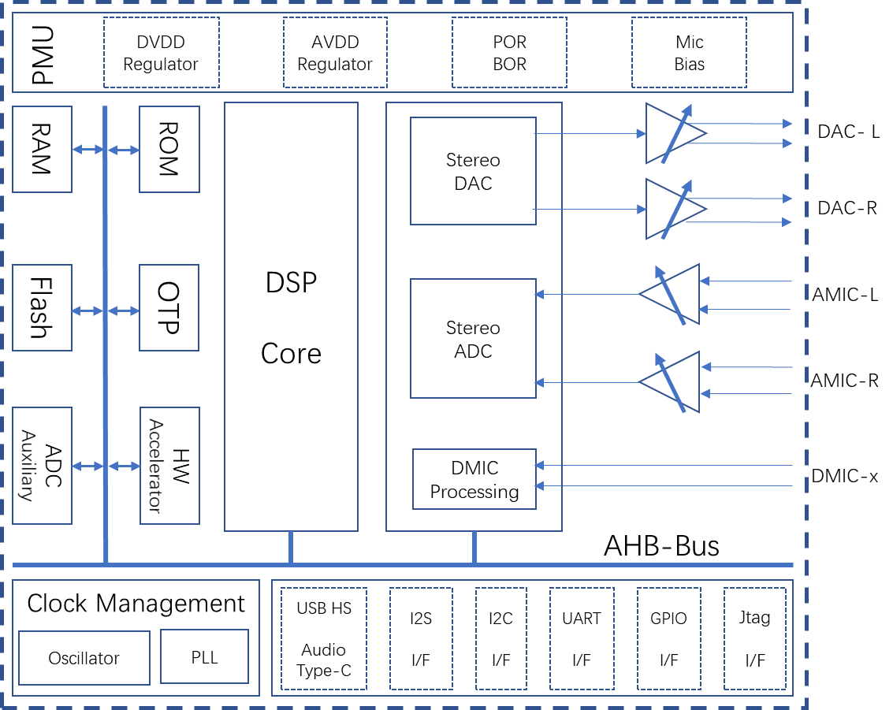
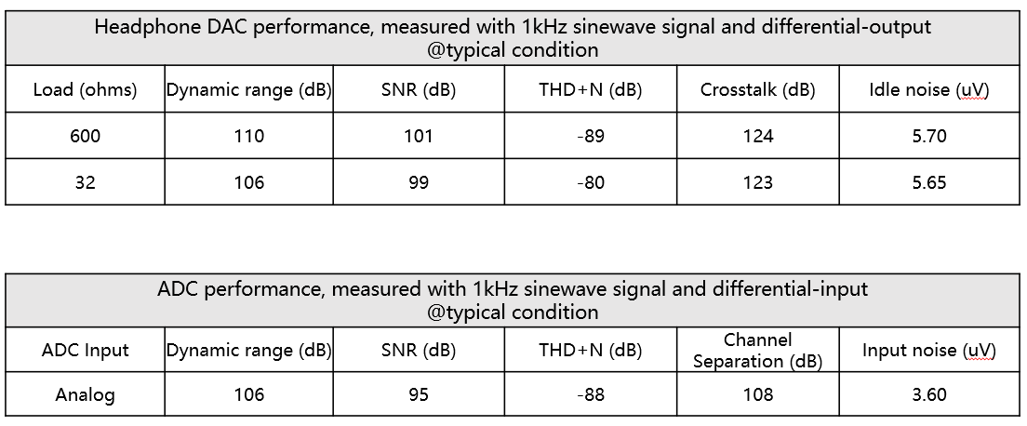
SNC8600 Profile
IC Architecture
Multichannel D/A audio interface
SNC8600 is an DSP which support muti-microphone voice control audio front-end signal processing solution
Based on the Tensilica's HiFi3 DSP Core, which well suited for feature-enhanced applications such as hearables, microphone-array devices, home entertainment, and automotive.
Support 24Bit high-performance analog differential input*2
Support 24Bit high-performance analog differential output*2
Support full-duplex I2S digital audio interface*3
Support USB2.0 HS device, support UAC1.0, UAC2.0 protocol
Support 24Bit high-performance digital microphone interface*10
Codec performance

Slide 4
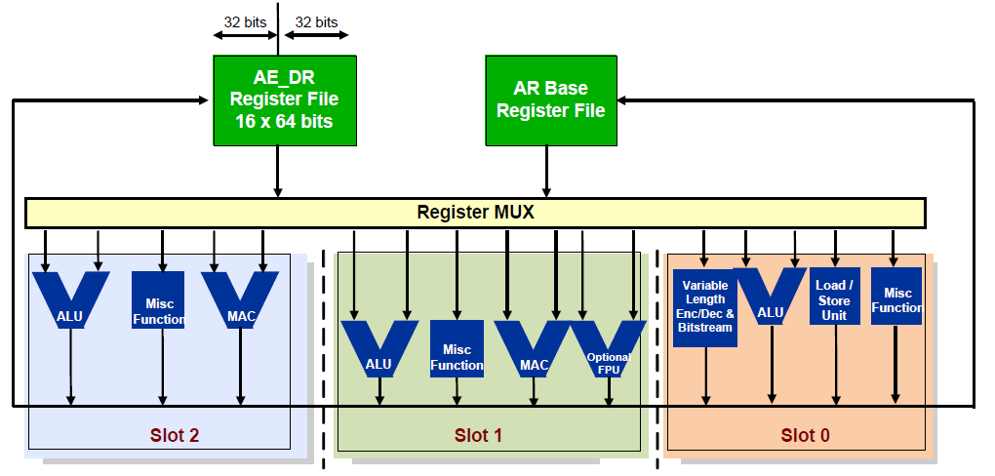
HiFi3 Architecture
Tensilica HiFi DSP
Tensilica HiFi DSP series is the most licensed audio/sound/speech processor
With support for over 300 proven software packages.
More than 125 software partners in the Tensilica Xtensions™ partner program
More than 100 top-tier semiconductor companies and system OEMs have selected Tensilica HiFi DSPs for their audio, voice and speech products
HiFi3 Architecture
HiFi 3 is a VLIW architecture, supporting the execution of three operations in parallel.
Goes beyond the two MAC, four multipliers, three VLIW slots,
Good support for 32x16-bit and 32x32-bit multiplication, a true 64-bit data path and native support for ITU-T/ETSI intrinsics.
an optional floating point unit available, providing for a
2-way SIMD, single-precision IEEE floating point MAC or ALU operation every cycle
HiFi3 DSP library
The HiFi 3 DSP has an associated generic DSP library，HiFi 3_VFPU_NatureDSP_Signal
The library contains functions for FIR filters, IIR filters, basic math functions, matrix operations, and FFTs.

Slide 5
SNC8600 Resources
Core & System
Architecture
In a typical application use case, it is used for a 24MHz oscillator
HiFi3 core as controller and audio DSP, up to 200MHz
Single cycle MAC, vector FPU, SIMD
64KB ROM for system booting, 512KB zero wait RAM, and 48KB zero wait cache
On chip 1MB NOR flash memory
One unique power supply from 3.3V to 5.5V.
DC-DC regulators and LDOs for all on chip supply voltages
Build-in hardware accelerators with BQ units.
HiFi3 is a 3 VLIW slots, good support for 32x16-bit and 32x32-bit multiplication
Support multiplication of 4 24-bit, or 4 32x16-bit, or 4 16x16-bit operands per cycle. Support 2 32x32-bit multiplies per cycle.
Through an optional floating point unit available, providing for a 2-way SIMD, single-precision IEEE floating point MAC or ALU operation every cycle
With the optional floating point unit, HiFi3 supports two IEEE-754 floating point MACs per cycle.
DSP
ISA & Arch.
Resource
Codec
Interface
Stereo 24bit ADC and DAC
DAC: SNR 100dB, THD+N: - 89dB, DR: 106dBA
ADC: SNR 95dB, THD+N: - 88dB, DR: 110dBA
Sample rate：8k, 16k, 32k, 48k, 96k, 192k
Up to 8-channel DMIC inputs
Support local audio processer: AGC、DRC、Mixer
Separate Gain controller for each channel：
Analog gain（12dB~-19dB, 1dB Step）
Digital gain（64dB~-64dB, 1dB Step）
Codec
1* 256bits eFuse.
1*Uart uint.
2* Auxiliary ADC units.
16*GPIO, multiplexing with other interfaces
Type C U SB2.0 HS device, compliant with Audio Class Specification Rev1.0 and Rev2.0
3*full-duplex I2S support up to 32Bit/192K sample rate
2*I2C controller, both support master & slaver mode

Slide 6
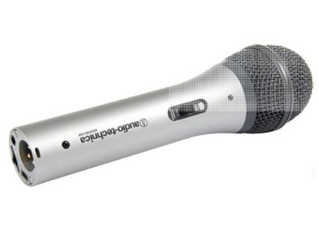
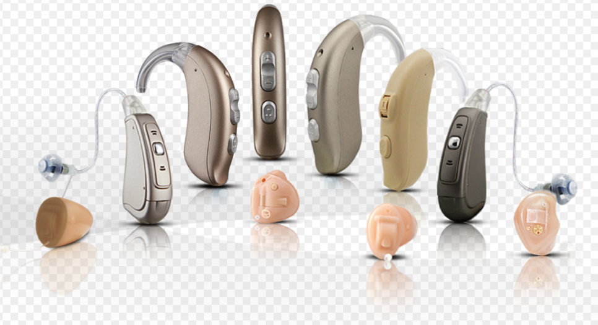
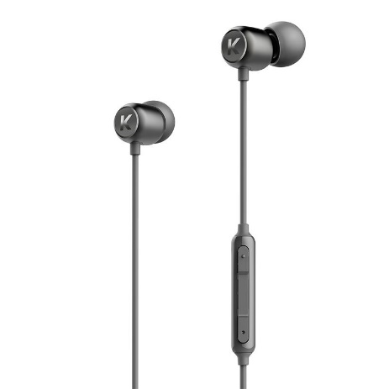
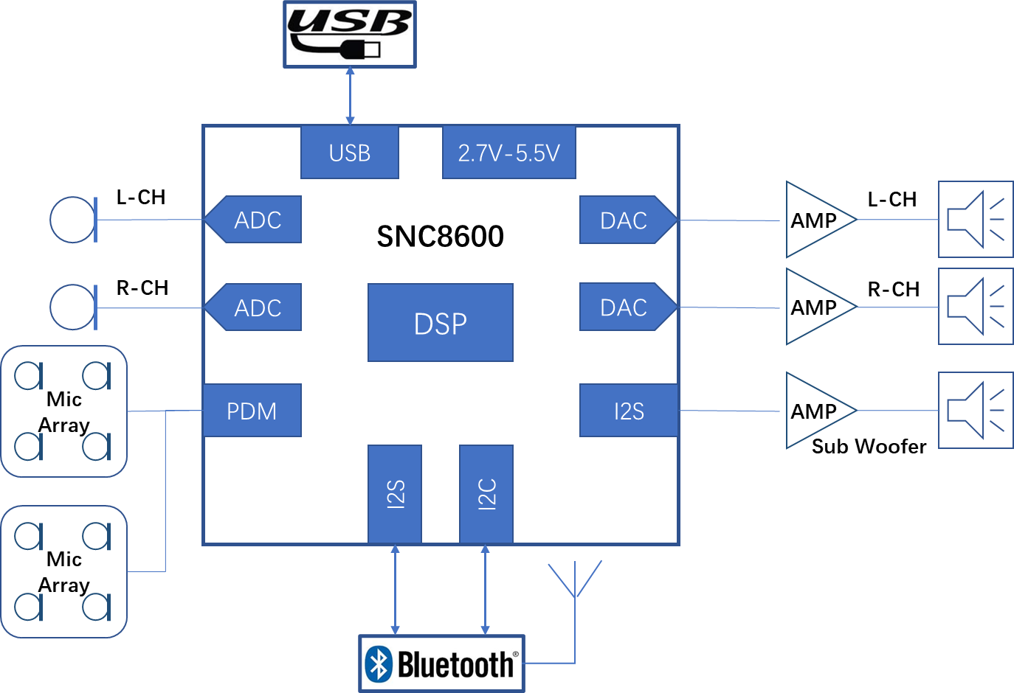
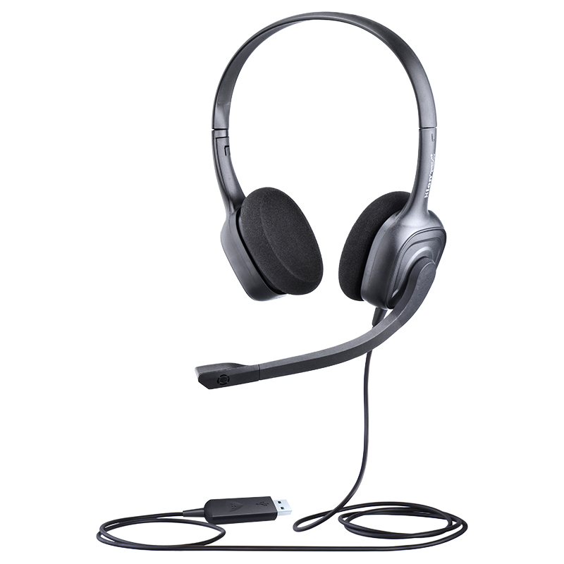
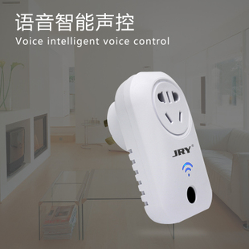
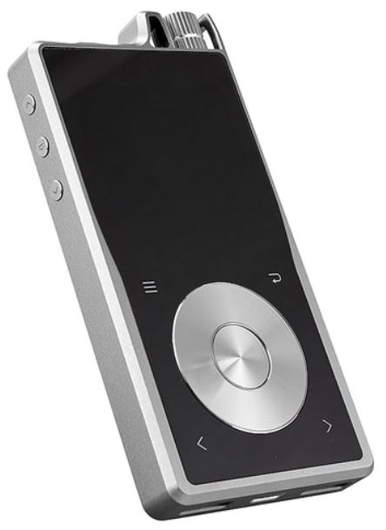
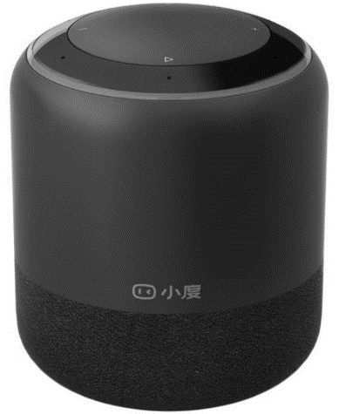
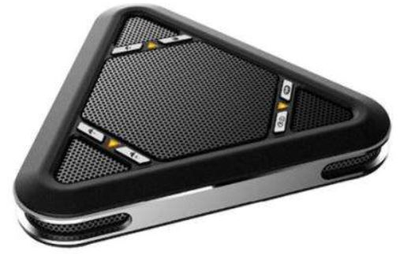
Application scenarios
USB Microphone
Hearing-Aid
Type-C earphone
Meeting pods(ENC)
IoT
Portable Speakers
Hi-res audio player
Meeting box

Slide 7
SDK peformance
Topic： System efficiency Main clock： 220MHz Version ： SDK20_V1.0 |  |  |  |  |  |  |  |  | [Note] Under USB mode，Sampling accuracy is 24 bit
Sample rate | Audio Path
 | ADC->DAC |  | I2S->DAC |  | I2S->I2S |  | ADC->I2S |  | USB->DAC |  | ADC->USB
 | SDK resources occupation rate | Current idle period（MHz） | SDK resources occupation rate | Current idle period（MHz） | SDK resources occupation rate | Current idle period（MHz） | SDK resources occupation rate | Current idle period（MHz） | SDK resources occupation rate | Current idle period（MHz） | SDK resources occupation rate | Current idle period（MHz）
48K@32bit | 5.21% | 208.538 | 5.25% | 208.45 | 5.90% | 207.02 | 5.70% | 207.46 | 4.83% | 209.374 | 5.64% | 207.592
96K@32bit | 9.41% | 199.298 | 9.92% | 198.176 | 10.80% | 196.24 | 10.42% | 197.076 | 6.65% | 205.37 | 8.13% | 202.114
192K@32bit | 17.48% | 181.544 | 18.62% | 179.036 | 20.75% | 174.35 | 19.79% | 176.462 | 10.41% | 197.098 | 14.03% | 189.134

Slide 8
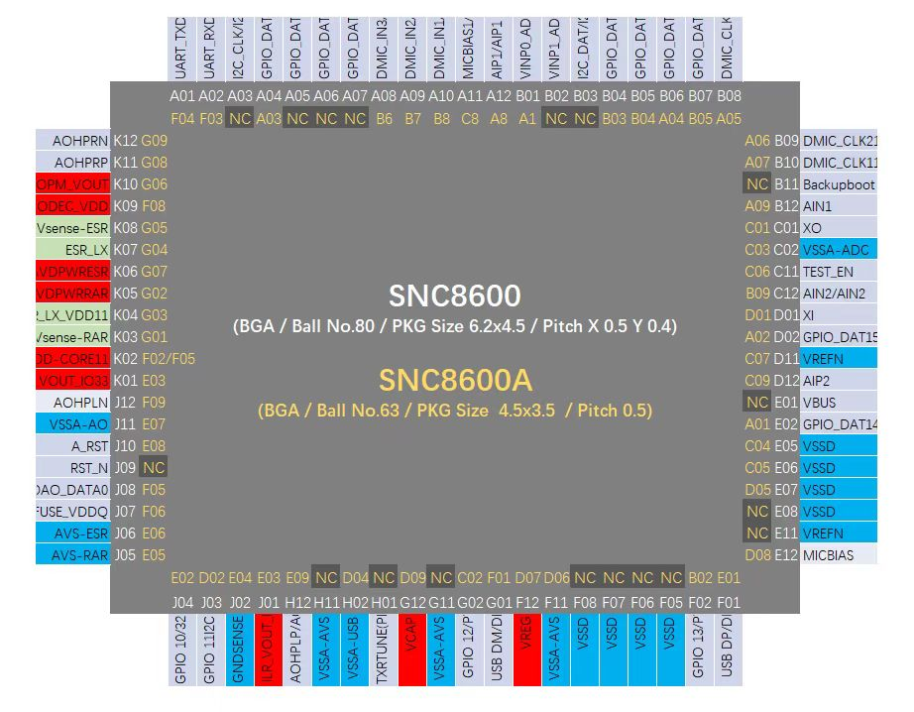
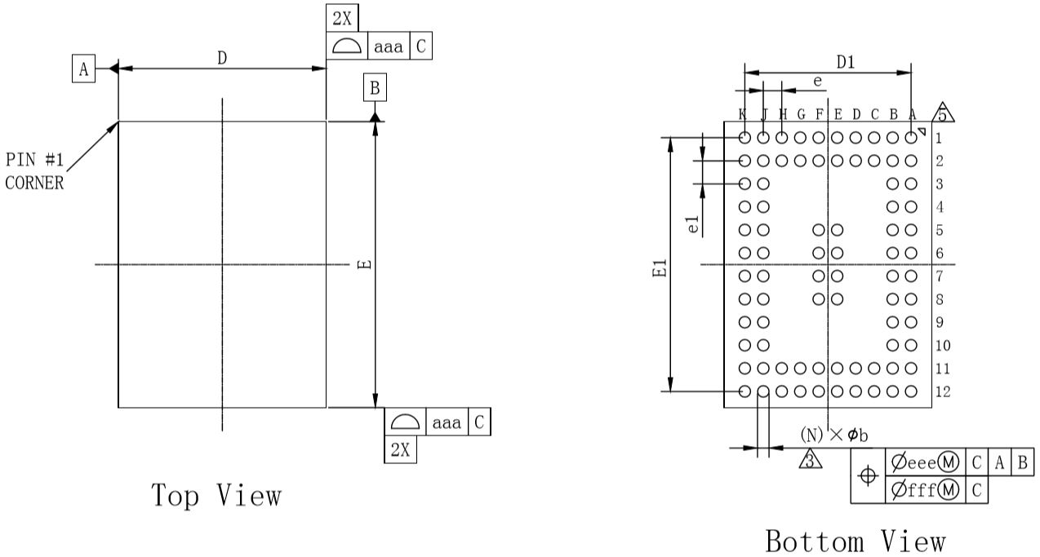
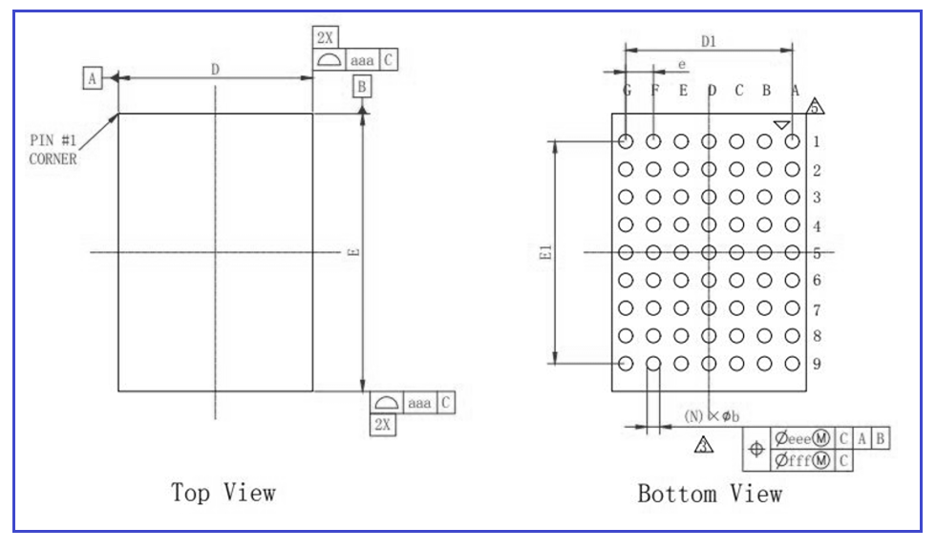
Package information
SNC8600: BGA80
E: 6.2mm
D: 4.5mm
e: 0.4mm
e1: 0.5mm
SNC8600A: BGA63
E: 3.5mm
D: 4.5mm
e: 0.5mm
e1: 0.5mm

Slide 9
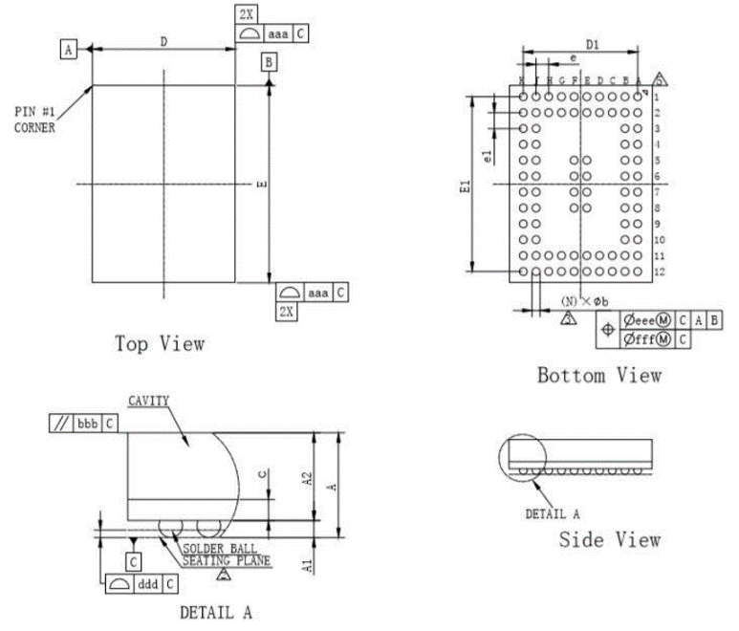
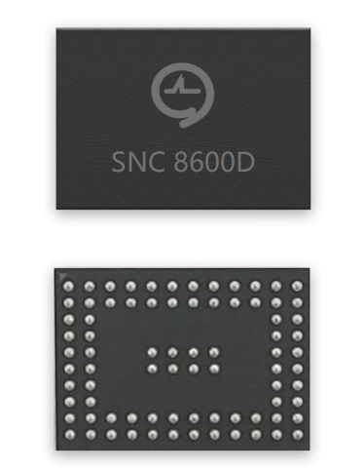
DSP Package information
Package
Details
80 Balls BGA:
x-direction 0.5mm pitch, y-direction 0.4mm pitch.
Body size is 6.2 x 4.5 mm

Slide 10

Soundec Technology
Thank you !

